Slide 1
Boiling
Year 7 Science

Slide 2

Review
Explain the difference between vaporisation, evaporation and boiling.
What happens to particles (and their energy) when they undergo evaporation?
Why do liquids cool as they start to evaporate?
Why are some liquids faster to evaporate than others, eg alcohol vs water?
What physical property of substances describes how fast they evaporate?
Hint it starts with V

Slide 3
Learning Intentions
Mixtures, including solutions, contain a combination of pure substances that can be separated using a range of techniques.

Slide 4
Success criteria
Distinguish between vaporisation, boiling and evaporation.
Investigate boiling point of different mixtures.

Slide 5


Boiling
At temperatures above boiling point, vaporisation is called boiling and the gas will form bubbles within the liquid.
Heating gives liquid particles the energy to overcome their bonds and ‘escape’ as gas.

Slide 6
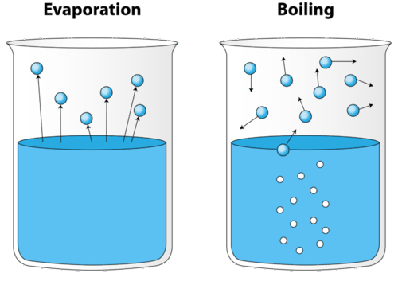
Vaporisation

Slide 7
Experiment: Investigating boiling

Slide 8
Don’t forget
Homework due Monday
Bring your diary Monday

Slide 9
Success criteria
Distinguish between vaporisation, boiling and evaporation.
Investigate boiling point of different mixtures.

